Slide 1
Expense Manager with Lending App
Jui Ashinkar NUID: 001443824
Rakesh Reddy Birika NUID: 001897118
Nishit Samir Ajmera NUID: 001818318
Tushar Sharma NUID: 001494599
Vinay Ramesh Kangokar NUID: 001401602

Slide 2
We pay now………..You pay later
Our app is an expense management system with lending option so that we pay all bills for user during a month and users can pay it once anytime later.
Users can track expenses, set an expense alarm and also stop worrying about the expenditures while they are out spending money.
Our aim is to make users realize about their financial state and give them insights how to spend more wisely.
We plan on associating with lenders for investments that we will use for lending to users when we pay their expenses.
Lenders will be getting a part of profits we earn from interest received back from users. Interest earned is going to be our major source of revenue.

Slide 3
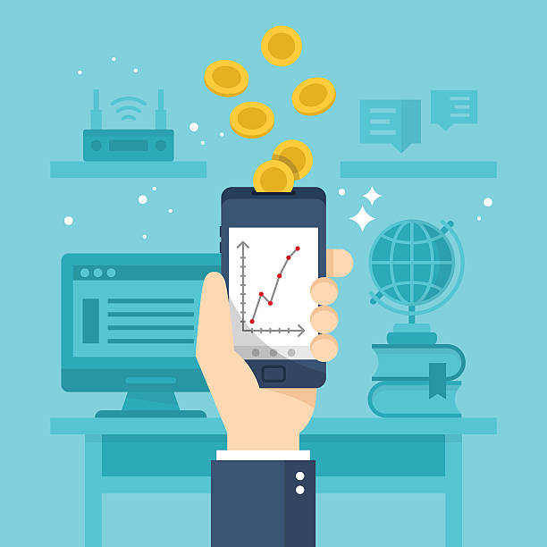
Objective
For Users
For Investors/Company
Lend money at cheaper interest rates
Help track/manage expenses
Help pay bills online
No monthly deadlines
Manage everything in one application
Benefit from interest earned from users
Collecting Transcation fees from Merchants

Slide 4
How it Benefits Users?
· Get interest free days – If you pay your balance in full before the statement period ends you will be rewarded with interest free days on future purchases for a set period.
· Works in any currency- make overseas purchase in a foreign currency with low currency conversion fee (conversion fee decreases with how often you spend on international transaction).
· Best during emergency
· Convenience- You don’t have to worry about how much cash you have on hand.
· Recordkeeping-The Application provides a useful record of your spending through your monthly statement and online account, which can be a great resource when you’re doing your taxes.
· Pay bills Online-Generally a normal credit card would encourage you to spend money that you don’t have, so you have 100$ and you may be able to spend up to 500$ to 1000$ on your credit card so it seems like free money at that time but this application will manage your expenses and will help you monitor your bills, that way you could control your spending and savings at once.

Slide 5
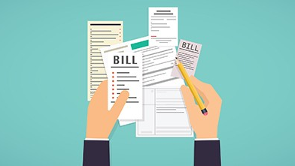
Pros of the application
It’s simple to set up and use.
The application will track all of your data for you daily
fast processes - delays, for example between paying bills and invoicing, are minimal
automation of tasks - calculating due bills, producing monthly statements/annual statements

Slide 6

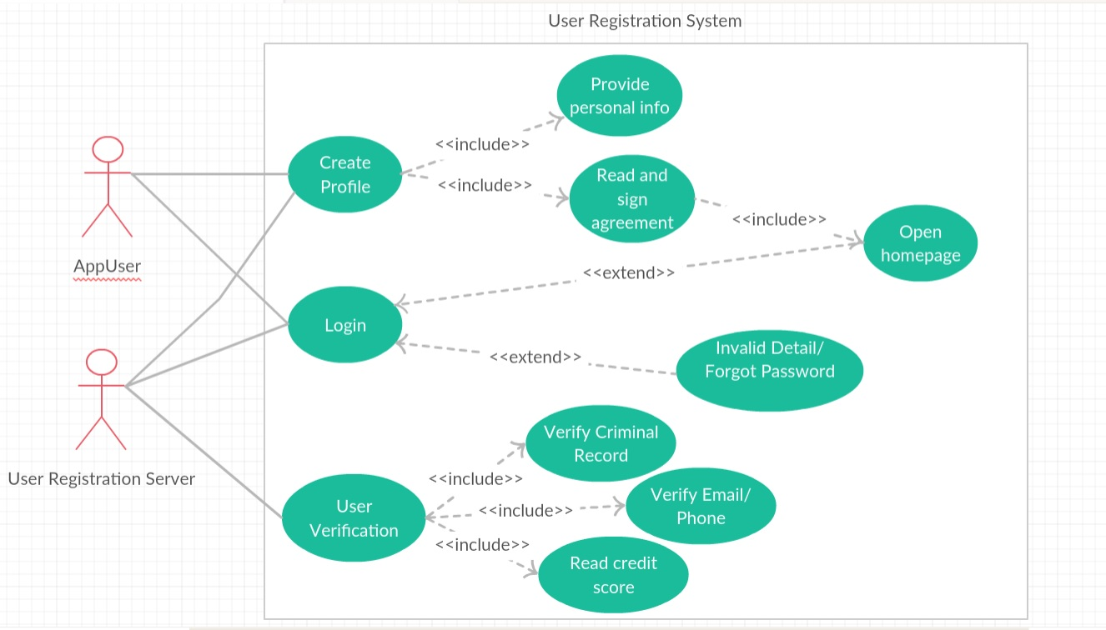



Sign-Up Use Case Diagram

Slide 7
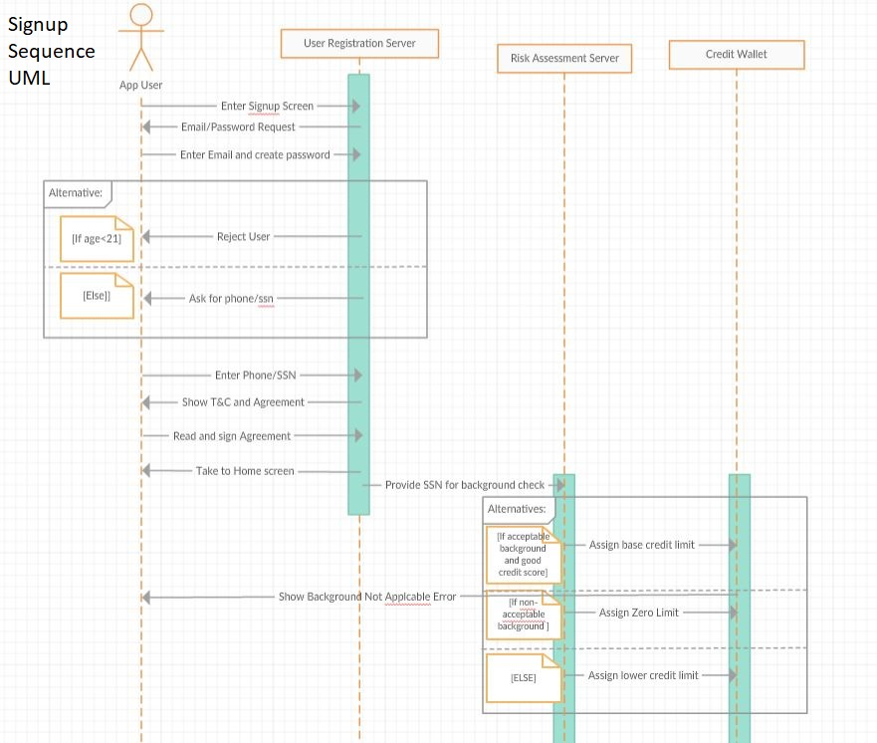
Sign-Up Process Sequence Diagram

Slide 8
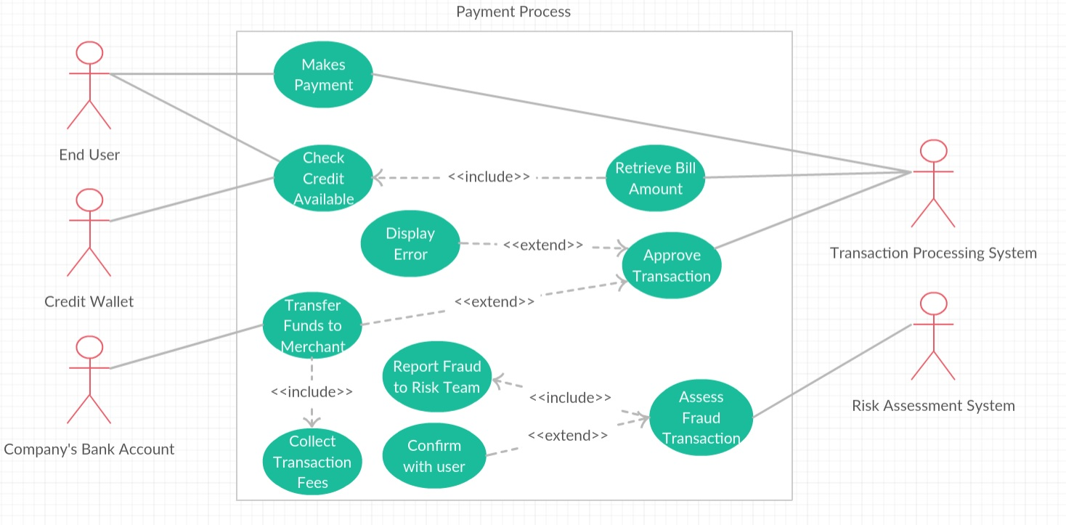
Payment Process Use Case Diagram

Slide 9
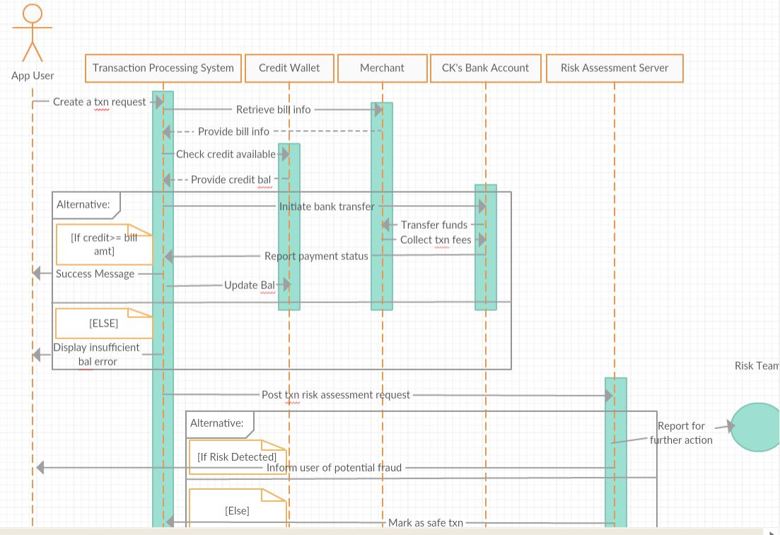
Payment Process Sequence Diagram

Slide 10
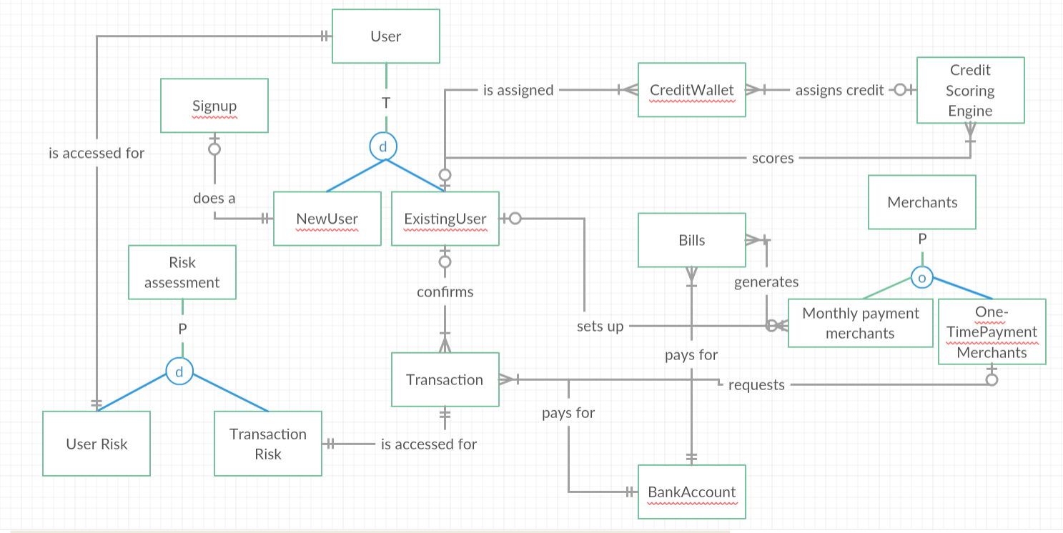
EERD

Slide 11
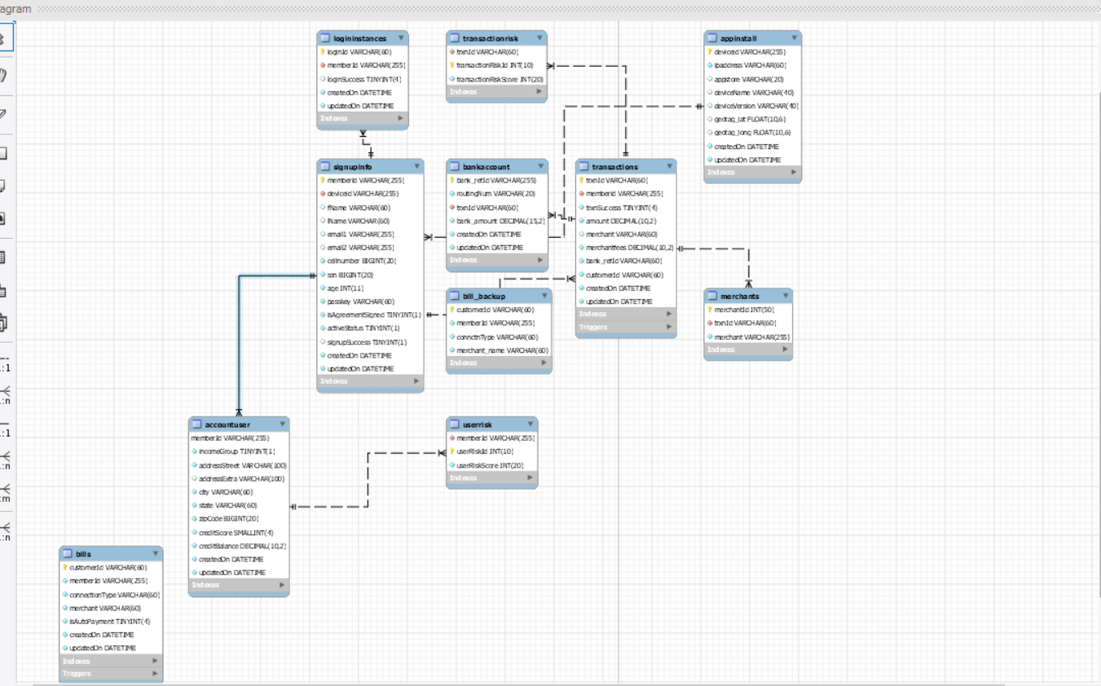

Slide 12

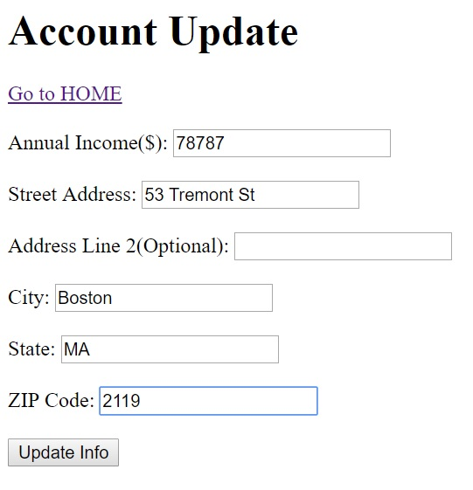
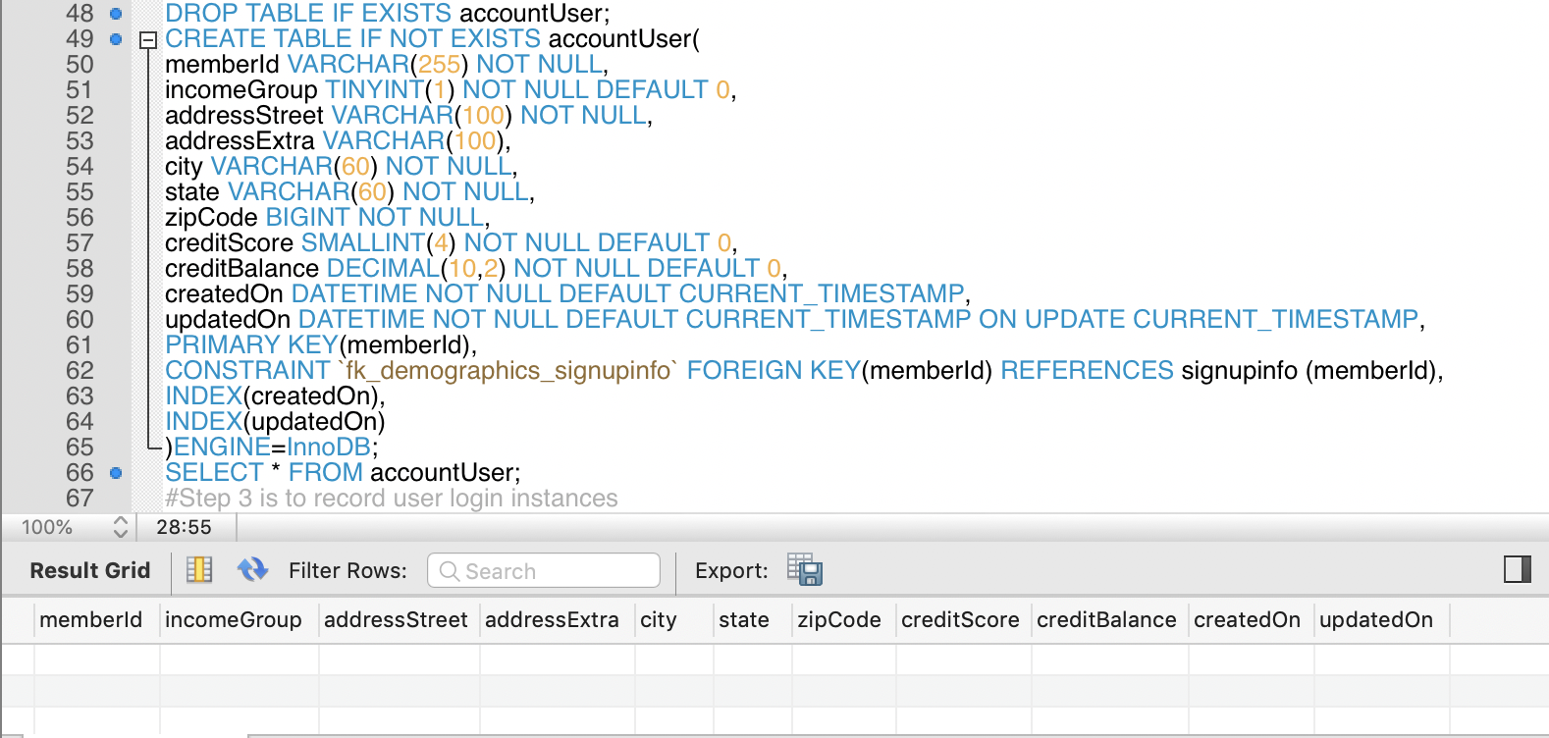
Create Account User Table

Slide 13
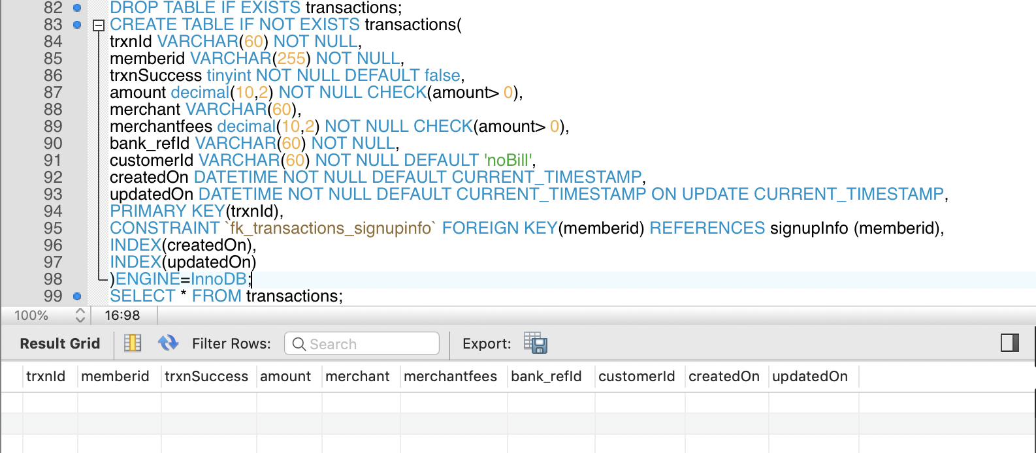
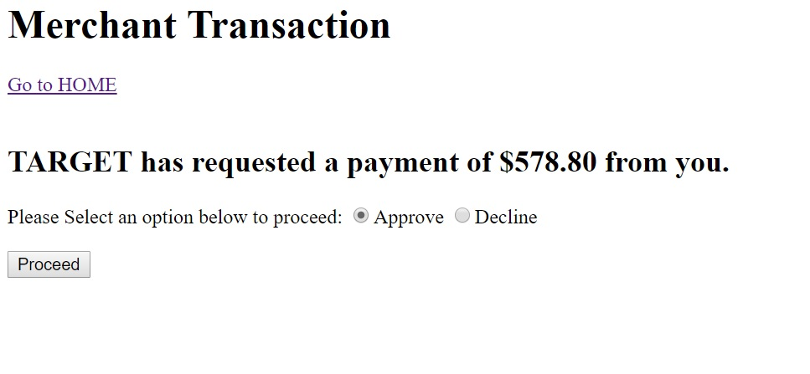
Create Transactions Table

Slide 14
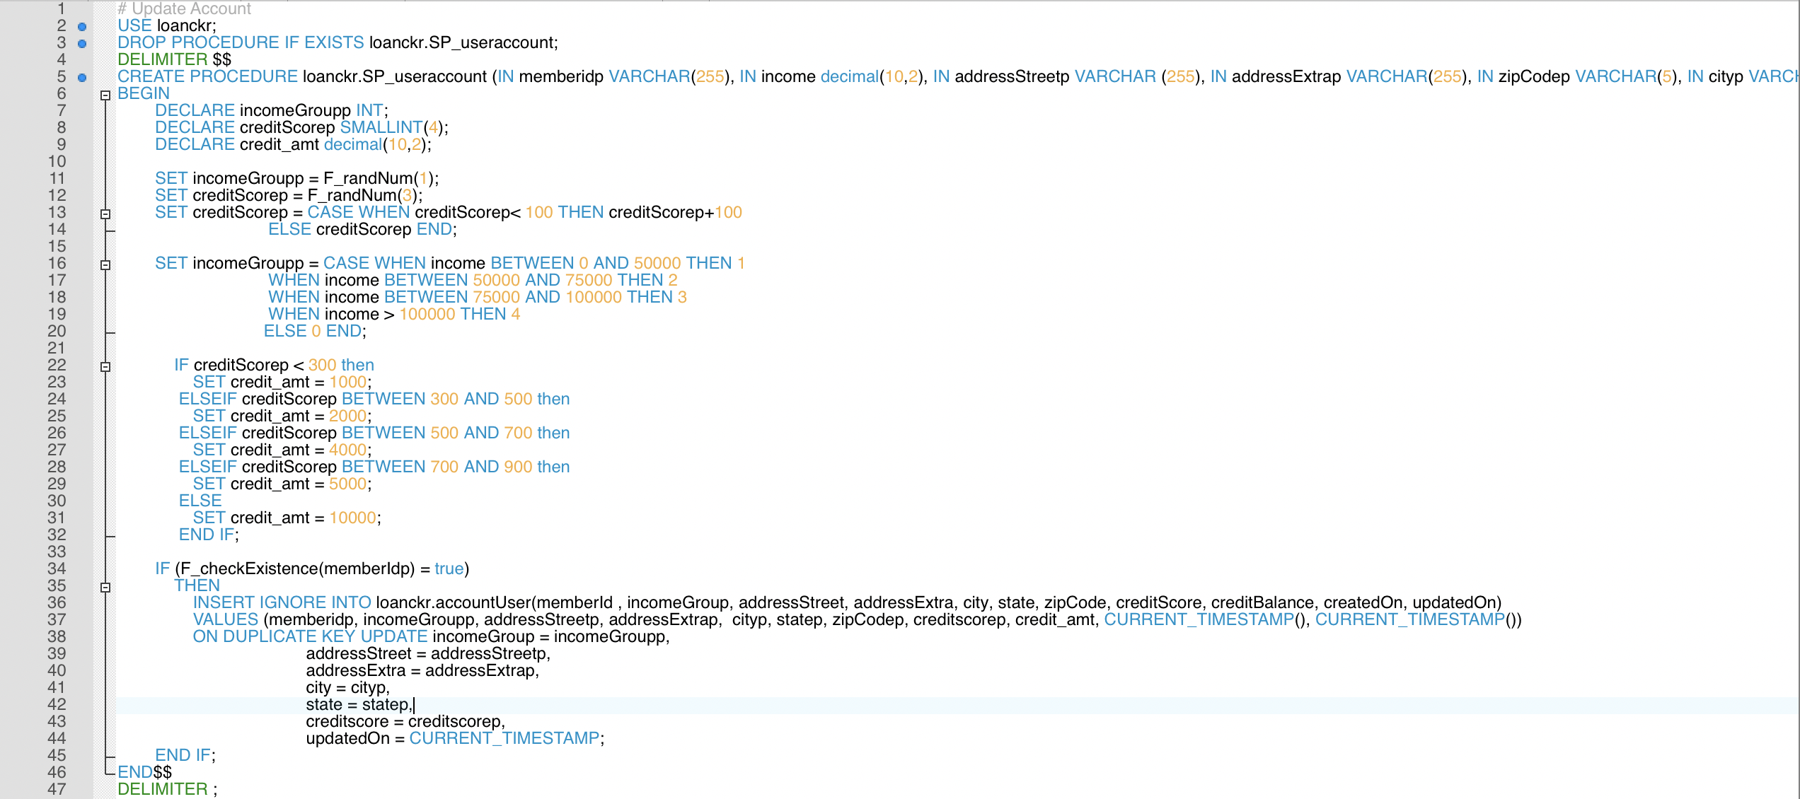
Procedure to Update Account

Slide 15
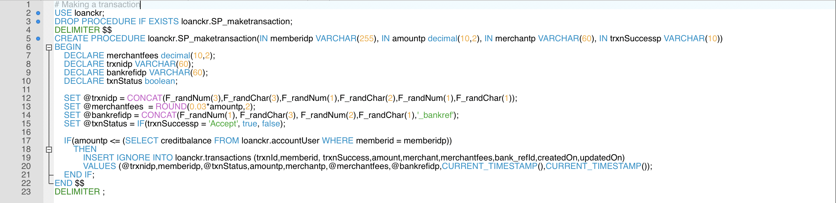
Procedure to Make A Transaction

Slide 16
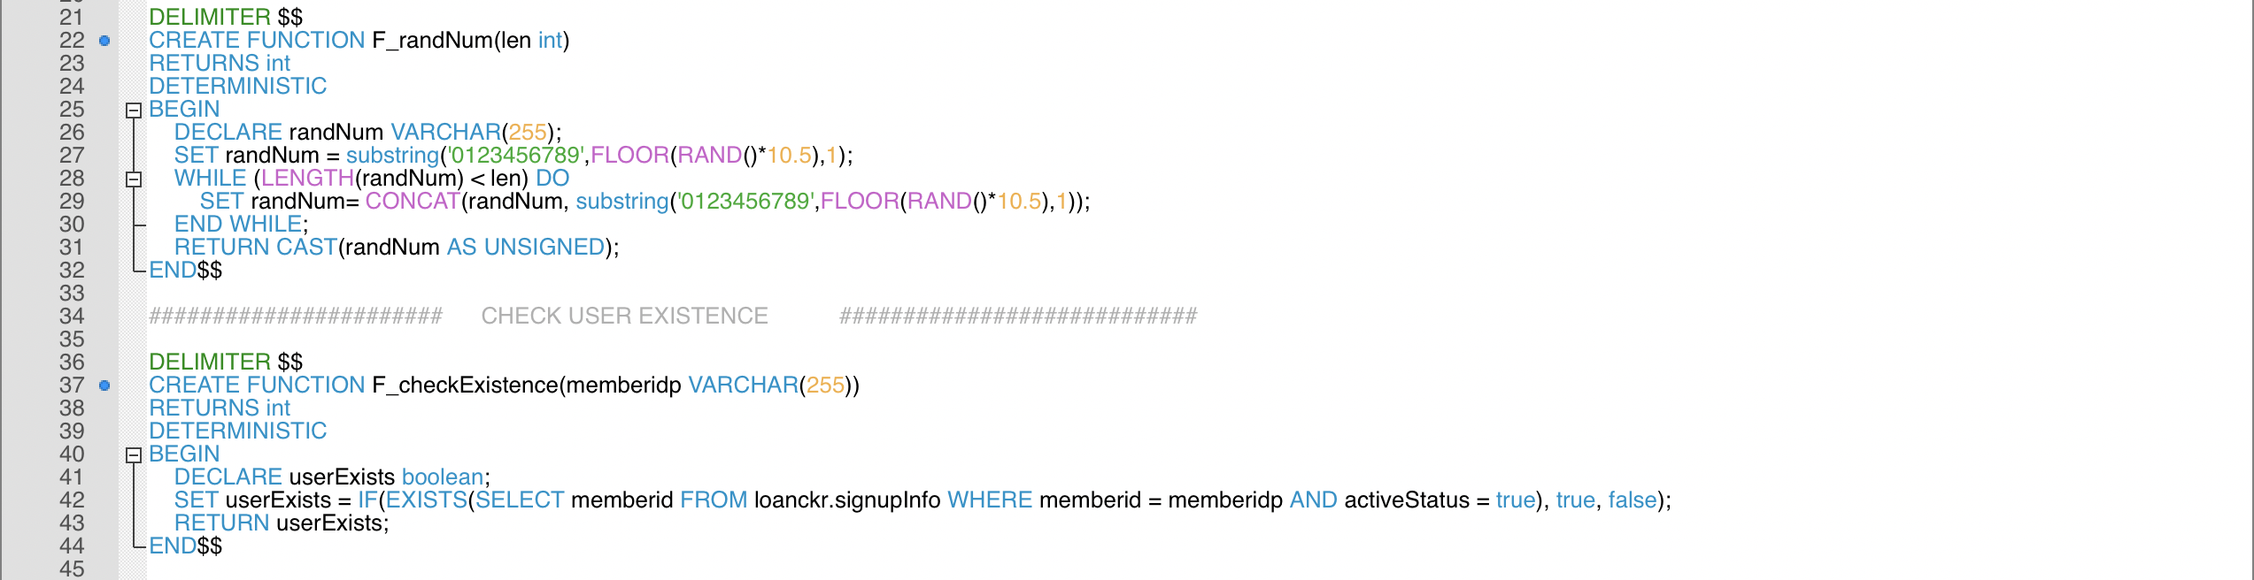
Functions

Slide 17
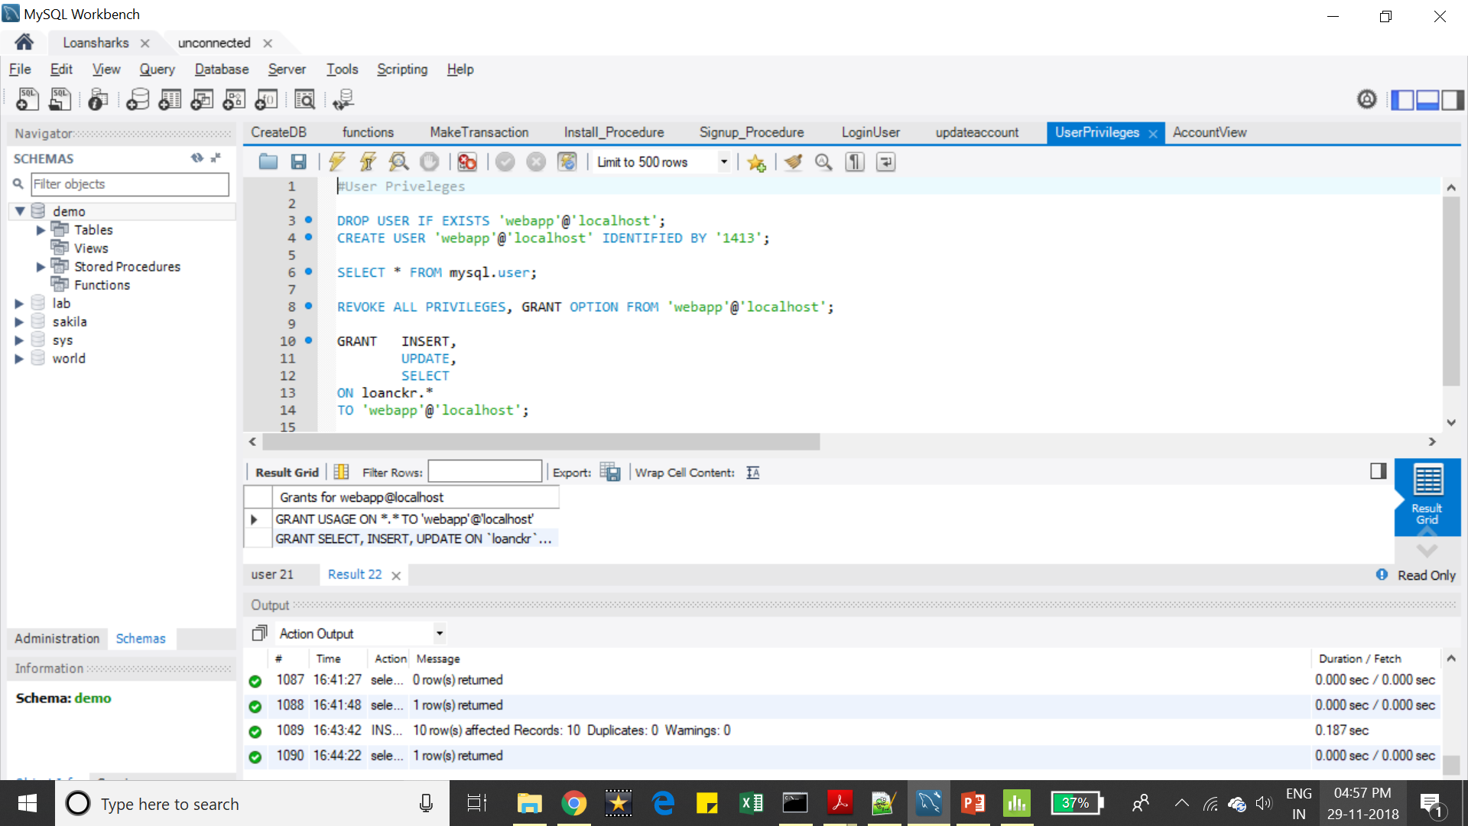
Granting Privilege to Web-App User

Slide 18

THANK YOU

